Slide 1
IR – Training – DAY 02
SOLID Design Development Principles

Slide 2
IR Training – Day 02 - Agenda
Introduction to SOLID Design Principle
Single responsibility principle
Open closed principle
Liskov substitution principle
Interface segregation principle
Dependency Inversion principle
Questions & Answers
References

Slide 3
IR Training – Day 02 - Introduction to SOLID Design Principle
Introduction:
SOLID are five basic principles whichhelp to create good software architecture. SOLID is an acronym where:-
S stands for SRP (Single responsibility principle
O stands for OCP (Open closed principle)
L stands for LSP (Liskov substitution principle)
I stands for ISP ( Interface segregation principle)
D stands for DIP ( Dependency inversion principle)

Slide 4
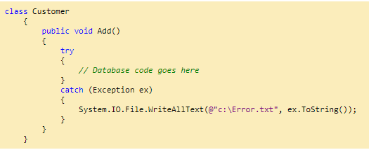
IR Training – Day 02 - Single responsibility principle
S.R.P for short - this principle states that:
A class should have one and only one reason to change, meaning that a class should have only one job.
Take below example:
The above customer class is doing things WHICH HE IS NOT SUPPOSED TO DO. Customer class should do customer datavalidations, call the customer data access layer etc , but if you see the catch block closely it also doing LOGGING activity. In simple words its over loaded with lot of responsibility.
So tomorrow if add a new logger like event viewer I need to go and change the “Customer”class, that’s very ODD.

Slide 5
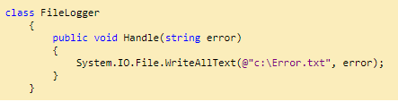
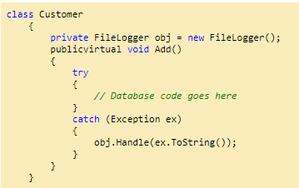
IR Training – Day 02 - Single responsibility principle
So SRP says that a class should have only one responsibility and not multiple.So if we apply SRP we can move that logging activity to some other class who will only look after logging activities.
Now customer class can happily delegate the logging activity to the “FileLogger” class and he can concentrate on customer related activities.
Now architecture thought process is an evolution. For some people who are seniors looking at above SRP example can contradict that even the try catch should not be handled by the customer class because that is not his work.
Yes, we can create a global error handler must be in theGlobal.asax file , assuming you are using ASP.NET and handle the errors in those section and make the customer class completely free.

Slide 6
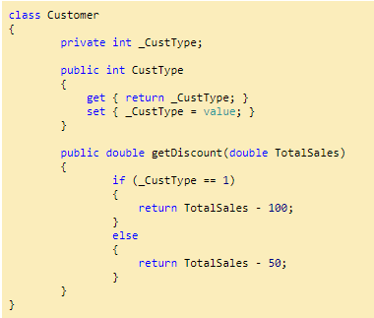
IR Training – Day 02 - Open closed principle
Objects or entities should be open for extension, but closed for modification.
Let’s continue with our same customer class example. I have added a simple customer type property to the class. This property decided if this is a “Gold” ora “Silver” customer.
Depending on the same it calculates discount. Have a look at the “getDiscount” function which returns discount accordingly. 1 for Gold customer and 2 for Silver customer.
Ok, also let me add a HINT, look at the “IF” condition in the “getDiscount” function.
The problem is if we add a new customer type we need to go and add one more “IF” condition in the “getDiscount” function, in other words we need to change the customer class.
If we are changing the customer class again and again, we need to ensure that the previous conditions with new one’s are tested again , existing client’s which are referencing this class are working properly as before.
In other words we are “MODIFYING” the current customer code for every change and every time we modify we need to ensure that all the previous functionalities and connected client are working as before.
How about rather than “MODIFYING” we go for “EXTENSION”. In other words every time a new customer type needs to be added we create a new class as shown in the below. So whatever is the current code they are untouched and we just need to test and check the new classes.

Slide 7
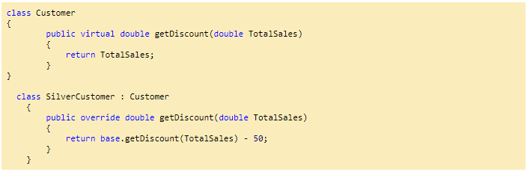
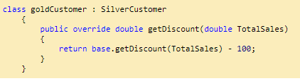
IR Training – Day 02 - Open closed principle
Putting in simple words the “Customer” class is now closed for any new modification but it’s open for extensions when new customer types are added to the project.

Slide 8
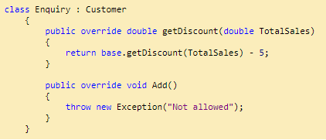
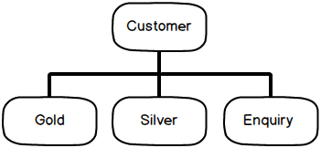
IR Training – Day 02 - Liskov substitution principle
Let q(x) be a property provable about objects of x of type T. Then q(y) should be provable for objects y of type S where S is a subtype of T.
Let’s continue with the same customer. Let’s say our system wants to calculate discounts for Enquiries. Now Enquiries are not actual customer’s they are just leads. Because they are just leads we do not want to save them to database for now.
So we create a new class called as Enquiry which inherits from the “Customer” class. We provide some discounts to the enquiry so that they can be converted to actual customers and we override the “Add’ method with an exception so that no one can add an Enquiry to the database.
If you visualize the current customer inheritance hierarchy it looks something as shown below. In other word “Customer” is the parent class with “Gold” , “Silver” and “Enquiry” as child classes.
So as per polymorphism rule my parent “Customer” class object can point to any of it child class objects i.e. “Gold”, “Silver” or “Enquiry” during runtime without any issues.
So for instance in the below code you can see I have created a list collection of “Customer” and thanks to polymorphism I can add “Silver” , “Gold” and “Enquiry” customer to the “Customer” collection without any issues.
Thanks to polymorphism I can also browse the “Customer” list using the parent customer object and invoke the “Add” method as shown in the below code.

Slide 9
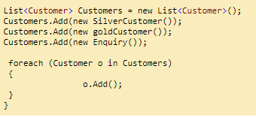
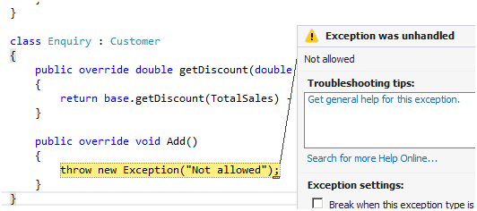
IR Training – Day 02 - Liskov substitution principle
HINT: -Watch when the Enquiry object is browsed and invoked in the “FOR EACH” loop.
As per the inheritance hierarchy the “Customer” object can point to any one of its child objects and we do not expect any unusual behavior.
But when “Add” method of the “Enquiry” object is invoked it leads to below error because our “Equiry” object does save enquiries to database as they are not actual customers.
In other words the “Enquiry” has discount calculation , it looks like a “Customer” but IT IS NOT A CUSTOMER. So the parent cannot replace the child object seamlessly. In other words “Customer” is not the actual parent for the “Enquiry”class. “Enquiry” is a different entity altogether.

Slide 10
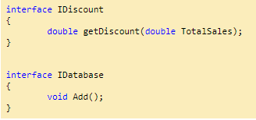
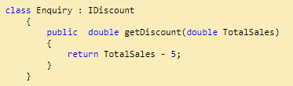
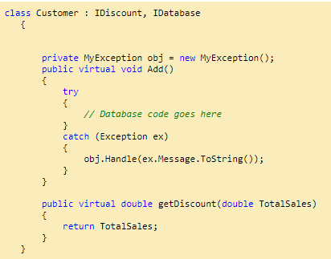
IR Training – Day 02 - Liskov substitution principle
So LISKOV principle says the parent should easily replace the child object. So to implement LISKOV we need to create two interfaces one is for discount and other for database as shown below.
Now the “Enquiry” class will only implement “IDiscount” as he not interested in the “Add” method.
While the “Customer” class will implement both “IDiscount” as well as “IDatabase” as it also wants to persist the customer to the database.

Slide 11
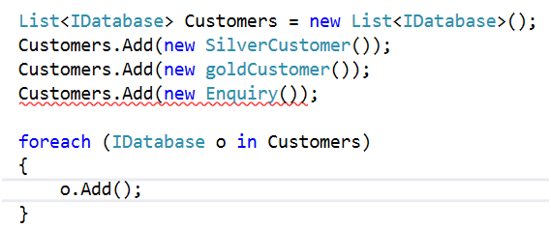
IR Training – Day 02 - Liskov substitution principle
Now there is no confusion, we can create a list of “Idatabase” interface and add the relevant classes to it. In case we make a mistake of adding “Enquiry” class to the list compiler would complain as shown in the below code snippet.

Slide 12
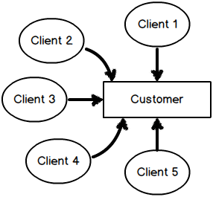

IR Training – Day 02 - Interface segregation principle
A client should never be forced to implement an interface that it doesn't use or clients shouldn't be forced to depend on methods they do not use.
Now assume that our customer class has become a SUPER HIT component and it’s consumed across 1000 clients and they are very happy using the customer class.
Now let’s say some new clients come up with a demand saying that we also want a method which will help us to “Read” customer data. So developers who are highly enthusiastic would like to change the “IDatabase” interfaceas shown below.
HINT: - Think about the effect of this change on the above image.

Slide 13

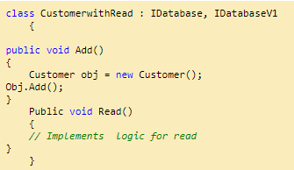
IR Training – Day 02 - Interface segregation principle
If you visualize the new requirement which has come up, you have two kinds of client’s: -
Who want’s just use “Add” method.
The other who wants to use “Add” + “Read”.
Now by changing the current interface you are doing an awful thing, disturbing the 1000 satisfied current client’s , even when they are not interested in the “Read” method. You are forcing them to use the “Read” method.
So a better approach would be to keep existing clients in their own sweet world and the serve the new client’s separately.
So the better solution would be to create a new interface rather than updating the current interface. So we can keep the current interface “IDatabase” as it is and add a new interface “IDatabaseV1” with the “Read” method the “V1” stands for version 1.
You can now create fresh classes which implement “Read” method and satisfy demands of your new clients and your old clients stay untouched and happy with the old interface which does not have “Read” method.

Slide 14

IR Training – Day 02 - Interface segregation principle
So the old clients will continue using the “IDatabase” interface while new client can use “IDatabaseV1” interface.

Slide 15
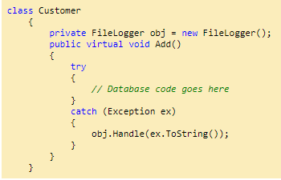
IR Training – Day 02 - Dependency Inversion principle
Entities must depend on abstractions not on concretions. It states that the high level module must not depend on the low level module, but they should depend on abstractions.
This principle allows for decoupling, an example that seems like the best way to explain this principle.
In our customer class if you remember we had created a logger class to satisfy SRP. Down the line let’s say new Logger flavor classes are created.
Just to control things we create a common interface and using this common interface new logger flavors will be created.

Slide 16
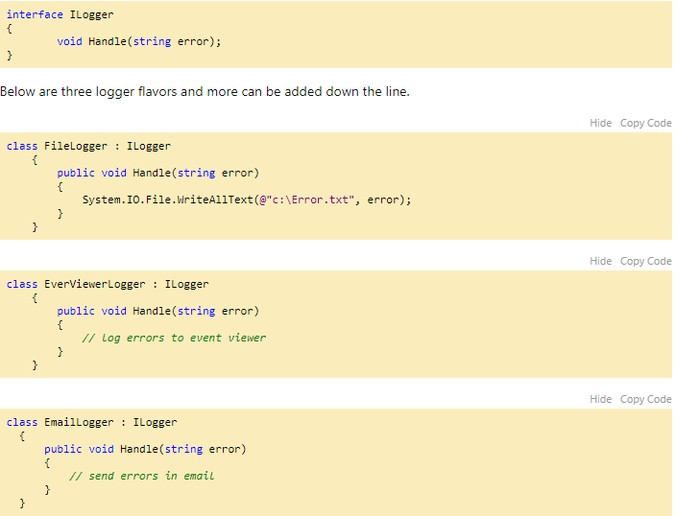
IR Training – Day 02 - Dependency Inversion principle

Slide 17
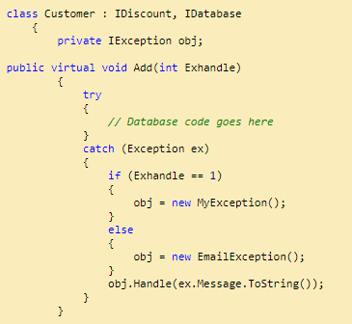
IR Training – Day 02 - Dependency Inversion principle
Now depending on configuration settings different logger classes will used at given moment. So to achieve the same we have kept a simple IF condition which decides which logger class to be used, see the below code.
HINT: - Watch the CATCH block code.
The above code is again violating SRP but this time the aspect is different ,its about deciding which objects should be created. Now it’s not the work of “Customer” object to decide which instances to be created , he should be concentrating only on Customer class related functionalities.
If you watch closely the biggest problem is the “NEW” keyword. He is taking extra responsibilities of which object needs to be created.
So if we INVERT / DELEGATE this responsibility to someone else rather the customer class doing it that would really solve the problem to a certain extent.

Slide 18
IR Training – Day 02 – Questions & Answers
Any Questions??

Slide 19
IR Training – Day 02 – References
https://www.codeproject.com/Articles/703634/SOLID-architecture-principles-using-simple-Csharp
https://scotch.io/bar-talk/s-o-l-i-d-the-first-five-principles-of-object-oriented-design#toc-open-closed-principle
https://www.codeproject.com/Tips/1033646/SOLID-Principle-with-Csharp-Example

Slide 20
IR Training – Day 02
THANK YOU

